Slide 1
6 Basic Camera Angles and Movements
Video Production 1A

Slide 2
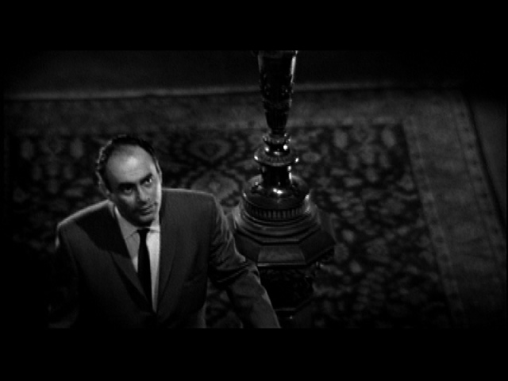
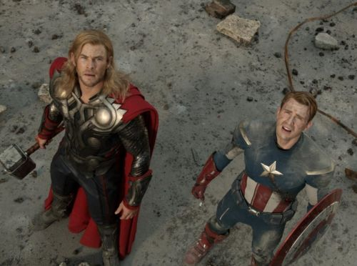
High Angle
Shoots at downward angle of the character
Makes them look weak or submissive
Shows unequal relationship
Examples

Slide 3
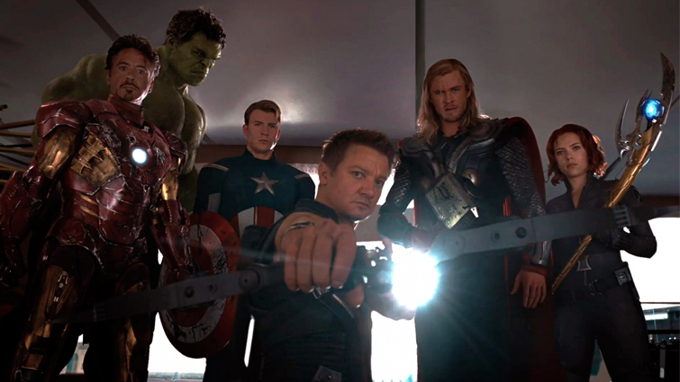
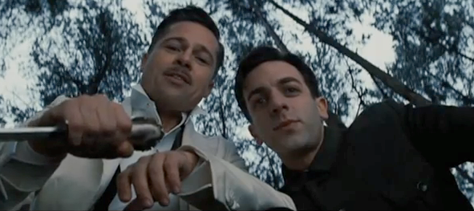
Low Angle
Shoots from a low position up toward the character
Makes the person look powerful or large
Still an unequal relationship
Example

Slide 4
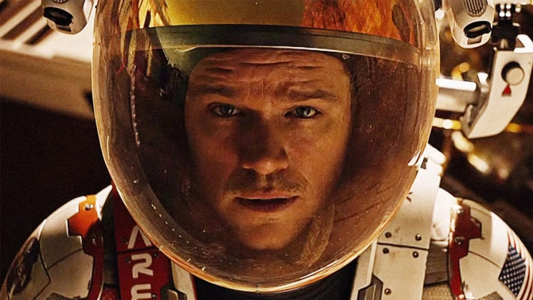
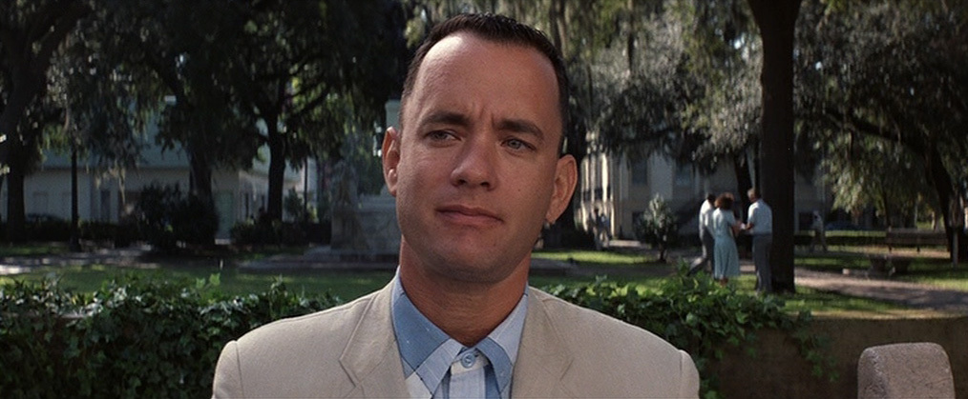
Eye Level
Camera is at same level as character’s eyes
Many times used to help audience identify with character
Good for equal relationship and dialogue
Example

Slide 5
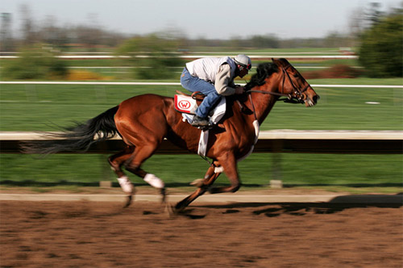
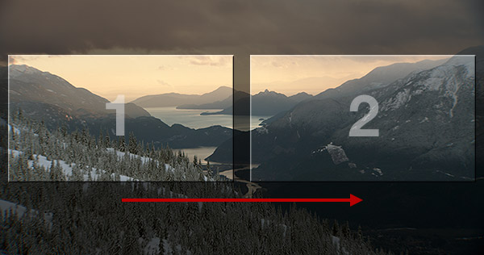
Pan
Pivoting the camera horizontally
Camera is fixed but turns left and right
Example

Slide 6
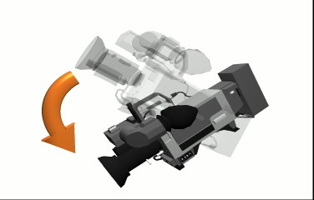
Tilt
Camera pivots up vertically
Camera is in fixed position but shifts up and down
Example

Slide 7
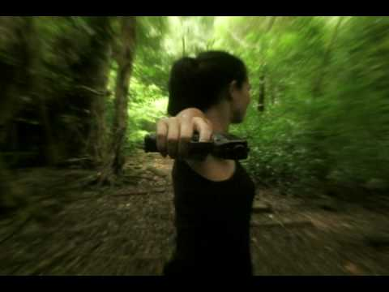
Zoom
Changing the length of the camera lens and depth
Can help take a wide shot and create a close up visa versa
Example

