Slide 1
6 Basic Camera Shots
Video Production 1A

Slide 2
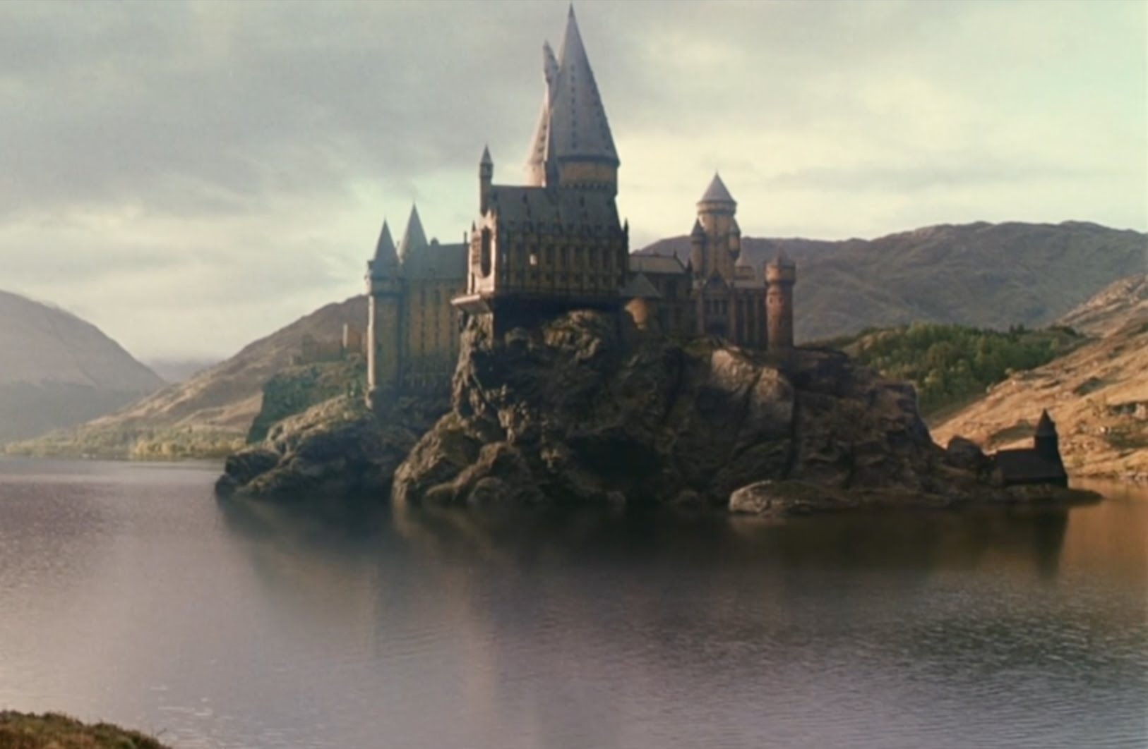
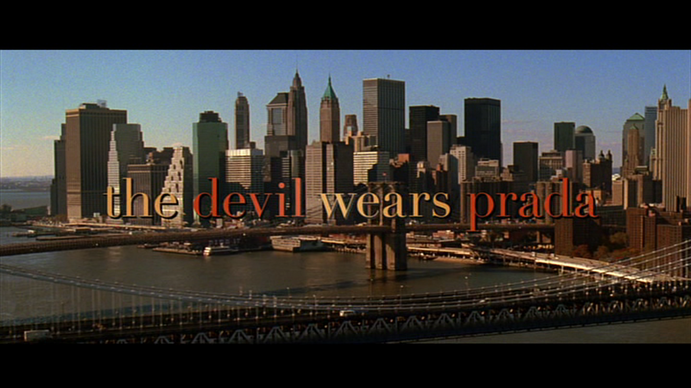
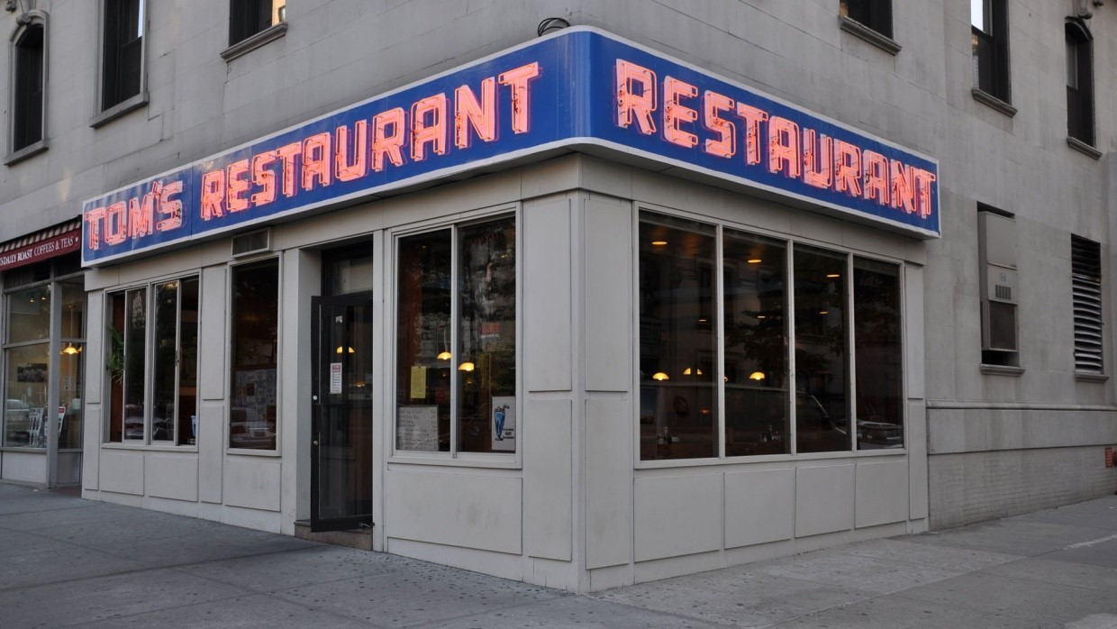
Establishing Shot
Sets up scene location (usually first)
Wide or Extreme Wide Shot
Many times it is just scenery
Examples

Slide 3
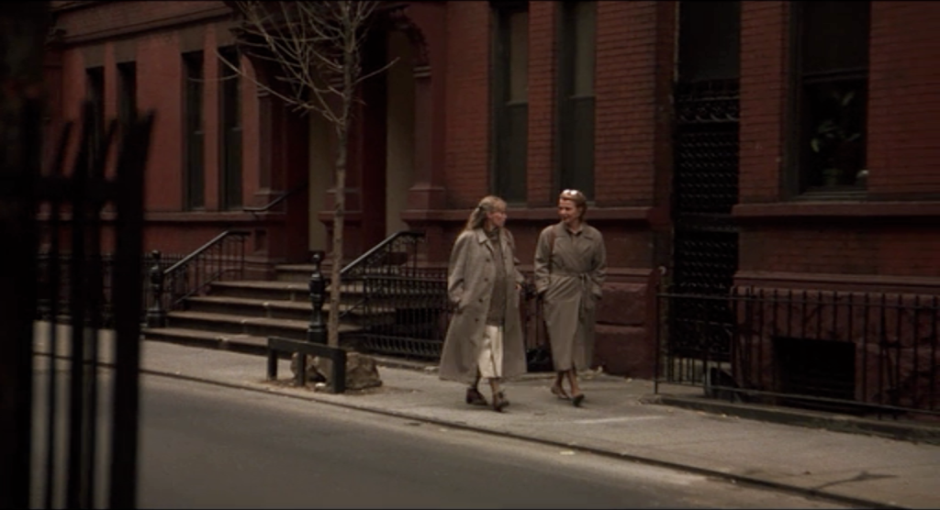
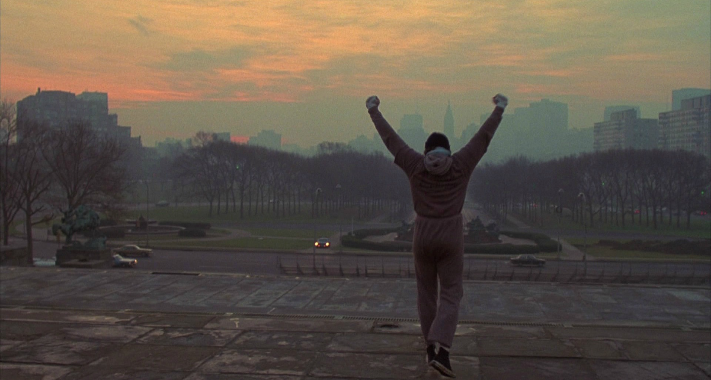
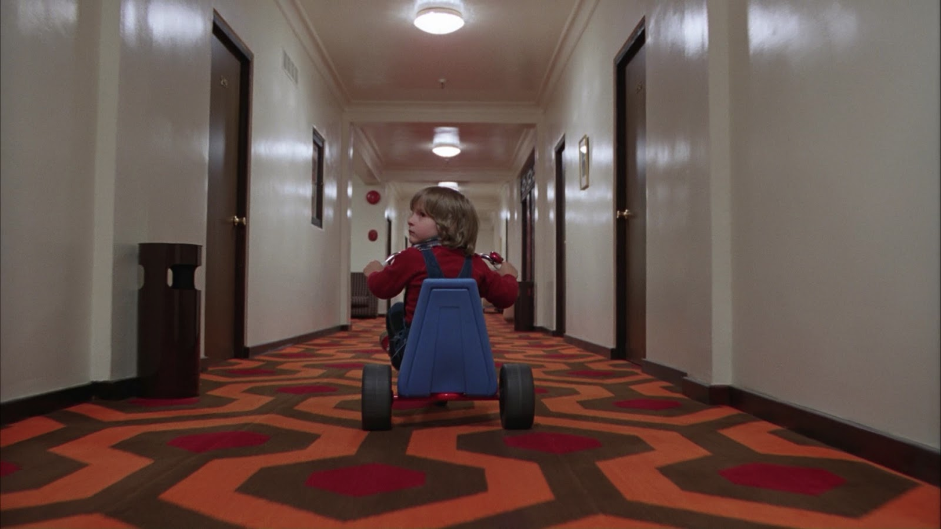
Wide Shot
Shows subject and surrounding area
Closer than Extreme Wide
Don’t Overuse

Slide 4
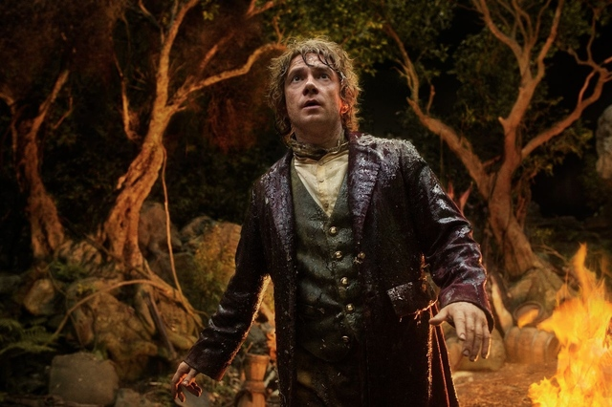
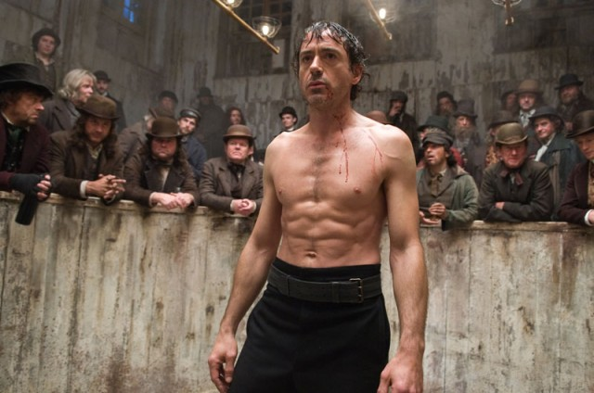
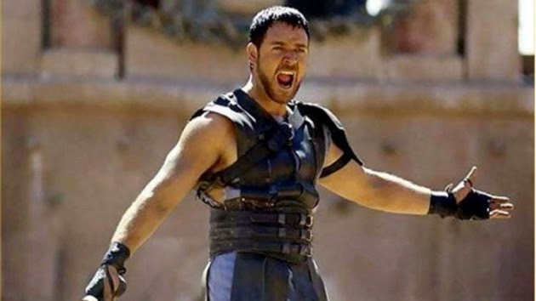
Medium Shot
Shows subject from knees up or mid body up
Show body language & background
Good for dialogue
Example

Slide 5
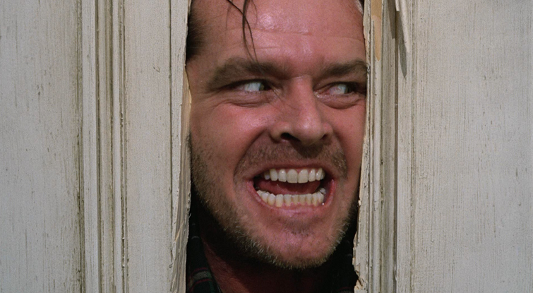
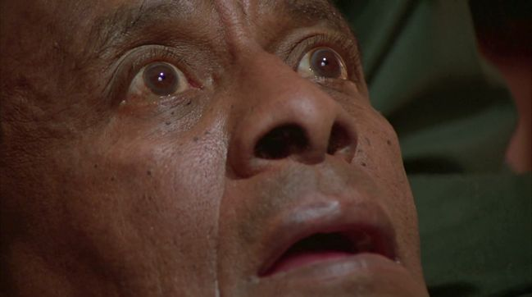
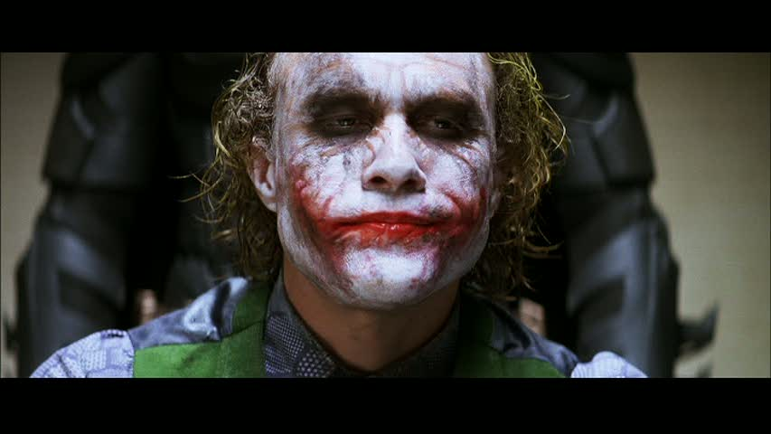
Close up
Focuses on part of a person or object
Used to highlight emotion or details
Sometimes can be a choker shot
Example

Slide 6
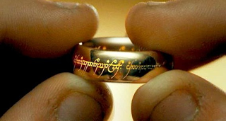
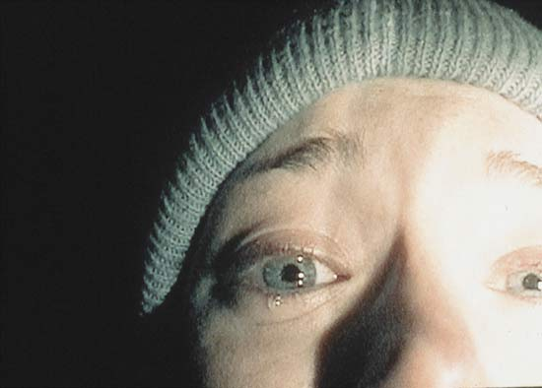
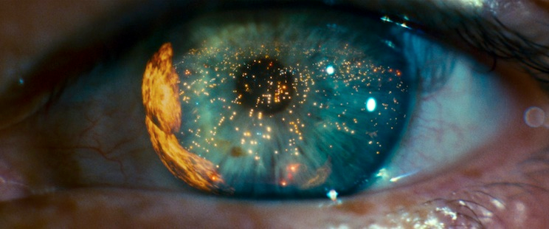
Extreme Close up
Magnified focus on details
Highlights emotion or detail even more
Can add tension to a scene
Example

Slide 7
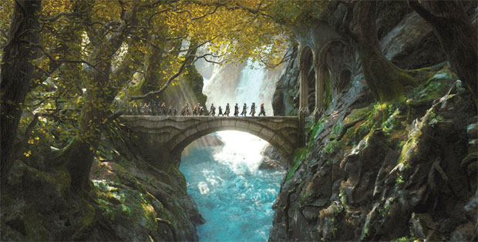
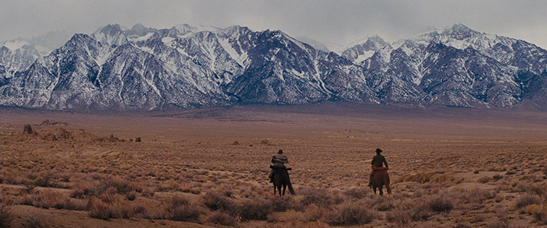
Extreme Wide Shot
Wide Shot with characters barely visible or not at all
Used a lot for Establishing Shot

